Slide 1

Watson Assistant Labs
Lab 1: Cognitive Chatbot Basics

Slide 2
Objective
Create a basic chatbot to help guide you when buying a new mobile phone
Watson Assistant

Slide 3
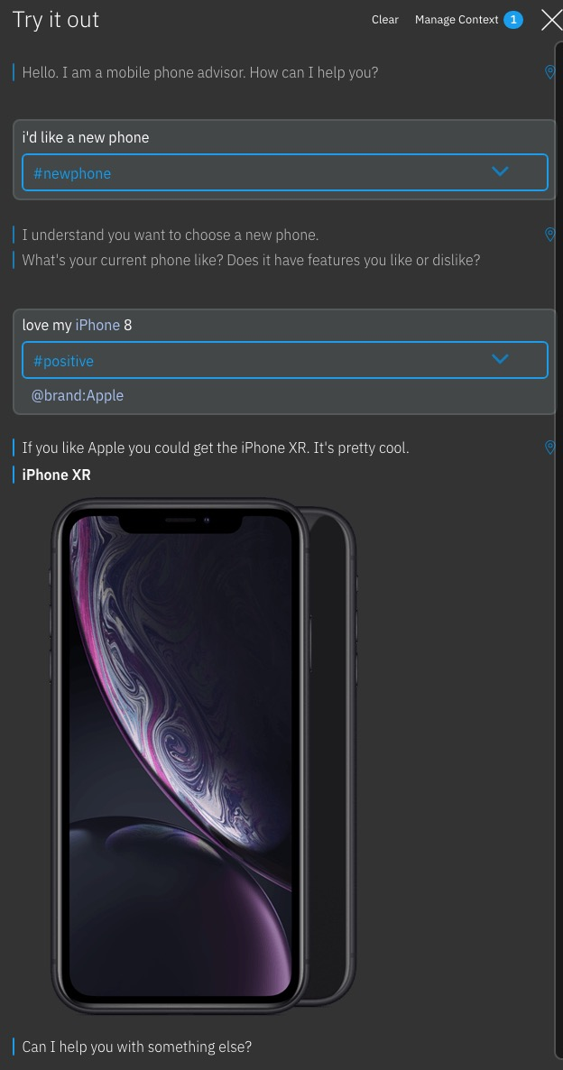
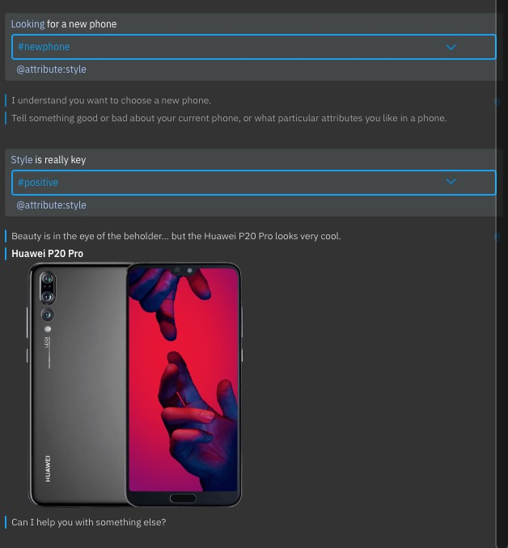
Objective

Slide 4

Agenda
Setup a Watson Assistant instance
Create a skill
Create intents, entities
Create a dialog tree utilising both intents and entities
Test your chatbot
Adding rich content: sending images

Slide 5
What is Watson Assistant?
Combines:
machine learning
natural language understanding
integrated dialog tools
… to create conversation flows between your apps and your users
Basic terms
Skill
a container for all of the artefacts that define a conversation flow
Intent
Entity
Dialog

Slide 6
Intents and Entities
Intents are a purpose or goal expressed by a user’s input
recognise user’s intent => choose the correct dialog flow / response
provide Watson Assistant with multiple examples (train)
Entities represent a class of object or a data type
can be used to trigger different responses, even for same intent
In our labs:
intents
newphone (‘I want to get a new phone’, ‘I’d like advice on a new mobile’,…)
positive (‘I like my Galaxy’, ‘I love my phone’, …)
negative (‘I don’t like my iPhone’, ‘I hate my mobile’, …)
entities
brand (Apple, Samsung, HTC, …)
attribute (style, battery, …)

Slide 7
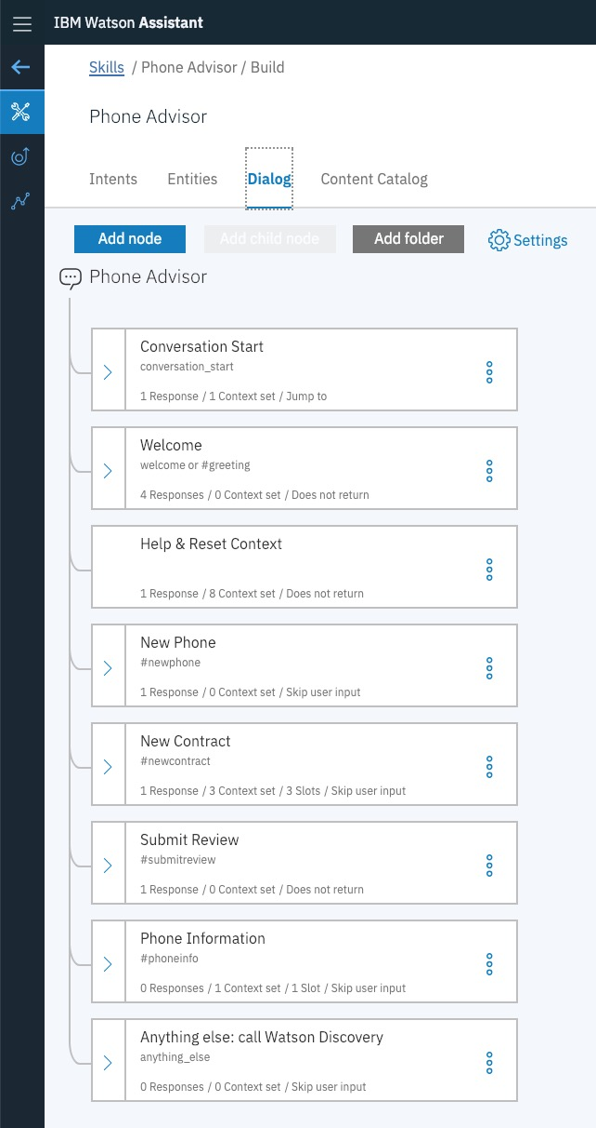
Dialog
Defines the flow of your conversation in the form of a logic tree
Each node of the tree has a condition that triggers it, based on user input
Uses intents and entities
Interacts with the user and provides a response
text, images, options

Slide 8
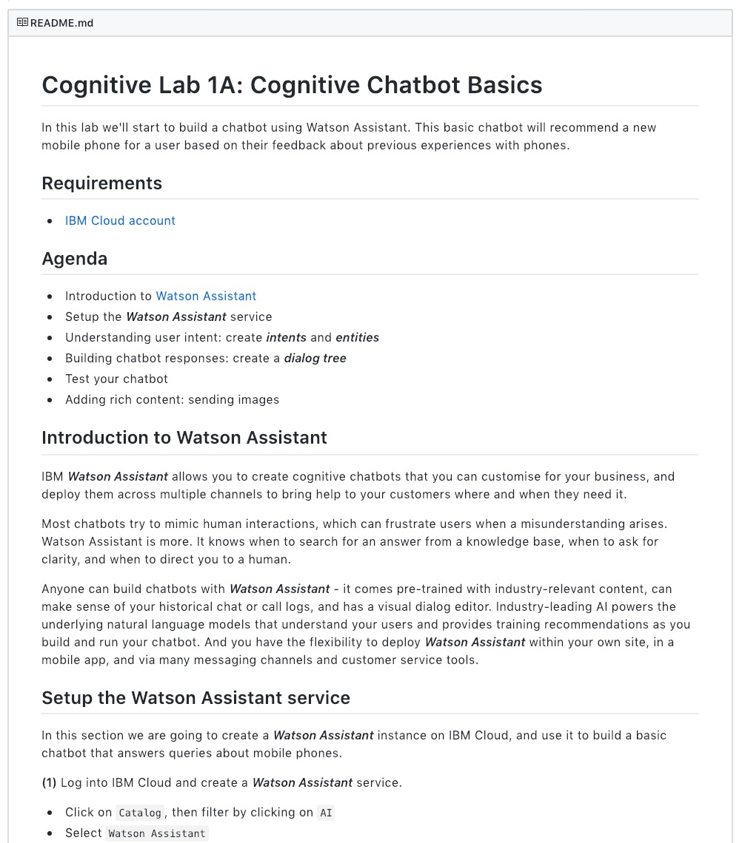
Lab Format
Step-by-step instructions
GitHub README.md for each lab
Work at your own pace
https://github.com/jenni-hautojarvi/Watson-Assistant-Labs/tree/master/1-Basics

Slide 9
Watson Assistant Labs
Lab 1: Cognitive Chatbot Basics

